Slide 1
Intro to Ethereum
Mike Rosack
mrosack@gmail.com
github.com/mrosack

Slide 2
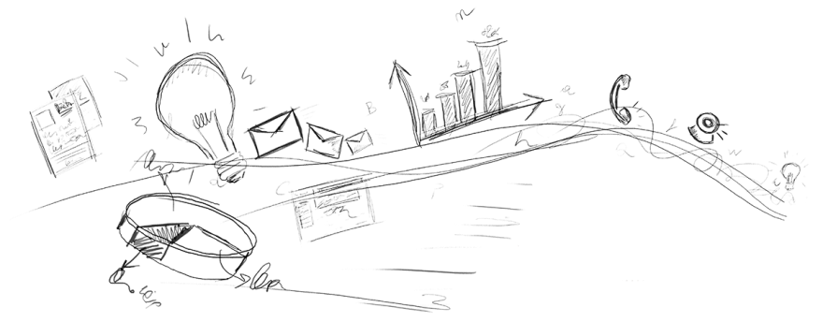

Quick Intro
About Me - Excited about blockchain tech, haven't done anything useful with it
Ethereum is still VERY beta, but “stable” release around Pi day
Killer app hasn't been written yet, and maybe not even dreamed of yet
Please ask questions!

Slide 3

Bitcoin introduced the Blockchain to the world...
But what really is a blockchain?

Slide 4
Shared Ledger
Global peer-to-peer network
Decentralized – no one controls the network, no one needs to be trusted
Transparent – every member of the network can see every transaction
Anonymous (but not untraceable)

Slide 5
Blocks
A “block” is a group of transactions, anyone can submit a transaction to the network to be included in a block
Blocks are “mined” by searching for a hash of all of the transactions in the block with an appropriate number of leading zeroes (“proof of work”), once network agrees that a block is valid work begins on the next block
Difficulty is adjusted to target a stable block generation time (15 minutes for Bitcoin)
The hash of the previous block is included in the current block, creating the “chain”. Because of this it's impossible to forge any block without forging them all!

Slide 6
Accounts (“Wallets”)
An account is simply a public/private key pair
To submit a transaction to the blockchain, it must be signed with the private key of the account
Obviously, losing your private key or having it stolen is irrecoverable
Transactions are validated by miners so you can't just send add anything to the chain

Slide 7
That's Great! But...
Bitcoin solved a very specific case of what blockchains could be used for.
Bitcoins can be transferred without having to trust anyone, but what if you want to conditionally send bitcoins? Who do you trust to escrow?
A global shared ledger is useful far beyond financial transactions:
Transparent voting / decentralized organizations
Notarization (proof of ownership)
Prediction markets
IOT?

Slide 8
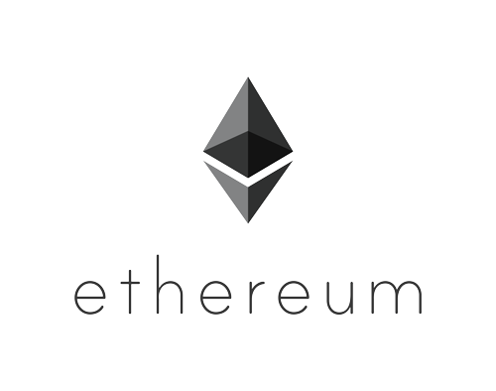
Introducing Ethereum
Turing complete blockchain: allows “Smart Contracts” to run on the blockchain
Integrates well with Javascript, allowing easy development of Ethereum-based web applications
15 second block time target

Slide 9
But why do we need Ethereum?
Can't we just extend Bitcoin?
People have been having this argument since Ethereum was announced...
Bitcoin does have a scripting language, but it's not fully turing complete
Lots of people are working on using Bitcoin “sidechains” to implement smart contracts (Counterparty is probably the most mature implementation, also Rootstock)
It may one day be just as easy to do smart contracts with Bitcoin as it is with Ethereum, but that day isn't today, and Ethereum is here. :)

Slide 10
How does Ethereum prevent overuse?
Gas!
Every operation performed in a smart contract costs “gas”
The price of gas is variable, contracts specify how much they're willing to pay for gas and miners can set how much they'll accept
Currently the price of gas is 1/100000 ether (which is a bit high, gas prices were fixed before the price of ether started going up - market will start dynamically adjusting soon)
Storing data on the blockchain also costs gas, storing a lot of data is prohibitively expensive

Slide 11
What are some examples of Ethereum Applications?
http://dapps.ethercasts.com/

Slide 12
So, how do I write an Ethereum app?
There's two main Ethereum clients, we'll do quick demos of both:
Mix IDE: “Visual Studio” for Ethereum. Much more user friendly, but very early preview and quite unstable
Geth: Go-based command line implementation. This is what real nodes on the network use to communicate, but can be a pain to install dependencies like the Solidity compiler.

Slide 13
What is an Ethereum App?
Code is written in a highish level language called Solidity, compiled to bytecode
Bytecode can be included in a network transaction, this turns it into a smart contract
Contracts can call other contracts, and you can also send a transaction to the network to call a contract without any other bytecode
You can also reference local methods on contracts without making transactions
You can create HTML/Javascript front ends to interact with contracts and send new transactions to the blockchain

Slide 14
DEMO
Mix IDE

Slide 15
DEMO
Azure Ethereum Quickstart / Geth
https://github.com/Azure/azure-quickstart-templates/tree/master/go-ethereum-on-ubuntu

Slide 16



APPLETON/GREEN BAY
4351 College Avenue
Suite 210
Appleton, WI 54914
MADISON
5250 East Terrace Drive
Suite 130
Madison, WI 53718
Thank you!
MILWAUKEE
2367 N. Mayfair Road
Suite 200
Wauwatosa, WI 53226

